Slide 1
A typical stroke in a young female?
Dr. Maha Al-istarabadi MD
Neurology Department
Skanes University Hospital
Malmo, Sweden

Slide 2
What role do modifiable and non-modifiable risk factors have in younger female stroke patients?
What could be the stroke etiology and how do we plan the diagnostic work-up?
How do we monitor and follow-up these patients?

Slide 3
Case
49 year old female
Arrives at the ER october 2020. Sudden onset of binocular diplopia and dizziness at work. Even dysphasia lasting several minutes.
Past medical history
Previous smoker
Migraine with aura
Suspected sleep apnea: Observed episodes of stopped breathing during sleep and loud snoring
Obese BMI 38
2015 one episode of weakness/parasthesia in right leg. No radiological signs of ischemia. Secondary prevention was not prescribed.
No family history of stroke
No prior medication

Slide 4
Clinical and neurological findings at admission:
Isolated diplopia without any other neurological deficits –dissolving after 5 hours
Normal physical examination
BP 220/110 mm Hg
Normal ECG, sinusrythm
Body temperature < 37,5 ^{O}
Glucose 6,1 mm/L

Slide 5
Radiological examinations
Ct-brain and Ct-Angiography extra-intracranial vessels normal
esp. posterior circulation
No signs of dissection including aortic arch
CT brain normal
CT angiography: extra and intracranial vessels including aortic arch normal

Slide 6
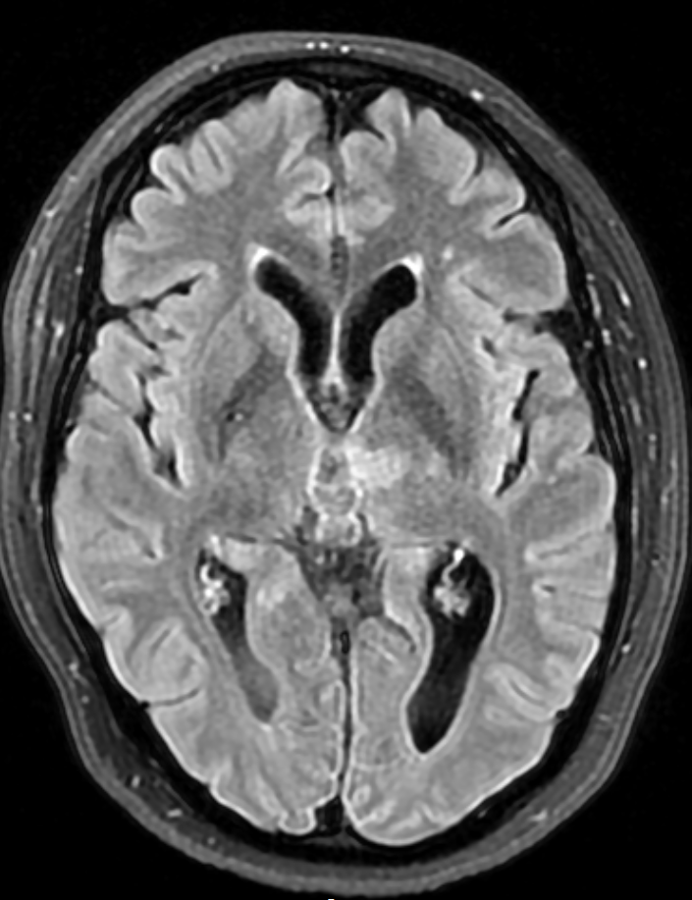
MRI brain at admission: 15 mm hyperintense lesion on Flair Sequences Left medial thalamus

Slide 7
Q1: Which of the following risk factors in the patients history has a stronger association with stroke in younger woman?
A.Smoking
B.Migraine with aura
C.Sleep apnea
D.Stress
Answer B –Migraine with aura is associated with ischemic stroke in younger women.
Sugested reading: Stroke 2007;38:2438-2445

Slide 8
Diagnostic work-up
24 hours heart monitoring – no signs of atrial fibrillation
Echocardiography – normal, no PFO.
Carotid ultrasound – no stenosis, no atherosclerosis
Laboratory examns - Blood tests: normal, including coagulation (antithrombin, protein c & s, lupus anticoagulant, cardiolipin antibody, DNA factor V mutation)
Embolic Stroke of Unknown origin?

Slide 9
Q2: Which risk factor shows a stronger association with stroke in older women?
A.Cardiovascular disease
B.Atrial fibrillation
C.Smoking
D.Hypertension
Stroke 2014 May;45(5):1545-88. doi: 10.1161/01.str.0000442009.06663.48. Epub 2014 Feb 6
- J Cereb Blood Flow Metab. 2018 Dec; 38(12): 2179–2191.
Answer: B
Although the prevalence of AF is higher in men, women have a higher risk for stroke and death due to AF as well as worse outcomes after stroke secondary to AF.

Slide 10
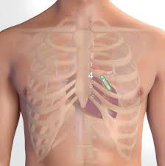
Treatment and follow-up
dietician
ASA 75 mg , Simvastatin 40 mg, Enalapril 5 mg
Regular follow-ups with control of BP
Control Diabetes
Physical activity
Contact with dietician for weight loss
Referral for diagnosis and treatment of sleep apnea
Extended cardiac work-up
Implantable cardiac monitor 1 year detection atrial fibrillation

Slide 11
Q3: Why are women more difficult to include in stroke trials?
A. They often refuse
B. Older at onset compared to men
C. They often present with severe symptoms, which makes an inclusion difficult
D. They are less women who suffer a stroke
Answer B
Women might be more difficult to include in trials because they tend to be older at stroke onset, have more comorbidities, and are more likely to have pre-existing functional impairment. Moreover, they are more likely to live alone than are men.
Nat Rev Neurol 13, 521–532 (2017)

Slide 12
Suggested reading
1.Madsen et al, Focused update- Impact of conventional risk factors on stroke in women: an update Stroke 2018; 49, 3 : 536-542
2. Probable Migraine With Visual Aura and Risk of Ischemic Stroke, Stroke 2007;38:2438-2445
3. Guidelines for the prevention of stroke in women: a statement for healthcare professionals from the American Heart Association/American Stroke Association. Stroke 2014 May;45(5):1545-88
4. Sex differences in stroke: Challenges and opportunities, JCerebBloodFlowMetab2018 Dec; 38(12): 2179–2191
5. Women and stroke: A matter of education? Nat Rev Neurol 13, 521–532 (2017)

